Slide 1
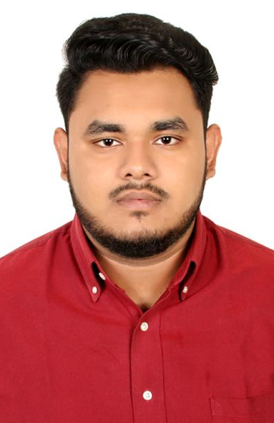
SIAM SHAHRIAR
Contact Info
Email: siam07443@gmail.com
Phone:01316885670
Address: South Banasree project, block: E, House: E-10
Objective
Passionate employee rights supporter looking to begin a role with the potential to make an impact within an organization.

Slide 2
Independent university, bangladesh
BBA IN HUMAN RESOURCE MANAGEMENT
DHAKA IMPERIAL COLLEGE (HSC, 2021) DEPARTMENT: Business Studies, GPA: 4.83
SRISTY ACADEMIC SCHOOL (SSC, 2019) DEPARTMENT: Science, GPA: 3.91
Education

Slide 3
Proprietor
Fast Food & Cafe Hungry Eats | South Banasree | 2023 to Present.
Senior photographer
L'Festiva | Dhaka | 2022-Present.
Senior photoGRAPHER
Labu Mahmood photography & wedding events| Dhaka | 2017 to Continue
Photographer
Food Panda Bangladesh | DHAKA | 2022-2023
Experiences

Slide 4
General Member, Independent
University Photography club, IUB
Coordinated with team members to ensure smooth event operations of SOTTE-3 event
which was organized by IUBPC.
Also, I participate in all day-to-day activity
of IUBPC.
VOLUNTEERING

Slide 5
Skills

